Slide 1


EDITING FOR CONCISENESS
Writing Support Desk
writingsupport@uwindsor.ca

Slide 2
IS THIS TOO WORDY?
In terms of writing, the most important tip that any expert at all could possibly provide is that it is absolutely vital to be sure to be as concise as possible to help your writing be understood clearly and directly by each and every reader. Due to the fact that wordy writing can be unclear, it is very important to be quite concise.

Slide 3
IS THIS TOO WORDY?
In terms of writing, the most important tip that any expert at all could possibly provide is that it is absolutely vital to be sure to be as concise as possible to help your writing be understood clearly and directly by each and every reader. Due to the fact that wordy writing can be unclear, it is very important to be quite concise.
62
words

Slide 4
IS THIS TOO WORDY?
In terms of writing, the most important tip that any expert at all could possibly provide is that it is absolutely vital to be sure to be as concise as possible to help your writing be understood clearly and directly by each and every reader. Due to the fact that wordy writing can be unclear, it is very important to be quite concise.

Slide 5
IS THIS TOO WORDY?
The most important writing tip that any expert at all could possibly provide is that it is absolutely vital to be sure to be as concise as possible to help your writing be understood clearly and directly by each and every reader. Due to the fact that wordy writing can be unclear, it is very important to be quite concise.

Slide 6
IS THIS TOO WORDY?
The most important writing tip that any expert at all could possibly provide is that it is absolutely vital to be sure to be as concise as possible to help your writing be understood clearly and directly by each and every reader. Due to the fact that wordy writing can be unclear, it is very important to be quite concise.

Slide 7
IS THIS TOO WORDY?
The most important writing tip that any expert could provide is that it is absolutely vital to be sure to be as concise as possible to help your writing be understood clearly and directly by each and every reader. Due to the fact that wordy writing can be unclear, it is very important to be quite concise.

Slide 8
IS THIS TOO WORDY?
The most important writing tip that any expert could provide is that it is absolutely vital to be sure to be as concise as possible to help your writing be understood clearly and directly by each and every reader. Due to the fact that wordy writing can be unclear, it is very important to be quite concise.

Slide 9
IS THIS TOO WORDY?
The most important writing tip that any expert could provide is that it is vital to be concise to help your writing be understood clearly and directly by each and every reader. Due to the fact that wordy writing can be unclear, it is very important to be quite concise.

Slide 10
IS THIS TOO WORDY?
The most important writing tip that any expert could provide is that it is vital to be concise to help your writing be understood clearly and directly by each and every reader. Due to the fact that wordy writing can be unclear, it is very important to be quite concise.

Slide 11
IS THIS TOO WORDY?
The most important writing tip that any expert could provide is that it is vital to be concise to help your writing be understood clearly by every reader. Due to the fact that wordy writing can be unclear, it is very important to be quite concise.

Slide 12
IS THIS TOO WORDY?
The most important writing tip that any expert could provide is that it is vital to be concise to help your writing be understood clearly by every reader. Due to the fact that wordy writing can be unclear, it is very important to be quite concise.

Slide 13
IS THIS TOO WORDY?
The most important writing tip that any expert could provide is that it is vital to be concise to help your writing be understood clearly by every reader. Because wordy writing can be unclear, it is very important to be quite concise.

Slide 14
IS THIS TOO WORDY?
The most important writing tip that any expert could provide is that it is vital to be concise to help your writing be understood clearly by every reader. Because wordy writing can be unclear, it is very important to be quite concise.

Slide 15
IS THIS TOO WORDY?
The most important writing tip that any expert could provide is that it is vital to be concise to help your writing be understood clearly by every reader. Because wordy writing can be unclear, it is important to be concise.

Slide 16
IS THIS TOO WORDY?
The most important writing tip that any expert could provide is that it is vital to be concise to help your writing be understood clearly by every reader. Because wordy writing can be unclear, it is important to be concise.
40
words

Slide 17
IS THIS TOO WORDY?
The most important writing tip that any expert could provide is that it is vital to be concise to help your writing be understood clearly by every reader. Because wordy writing can be unclear, it is important to be concise.
still
wordy!

Slide 18
IS THIS TOO WORDY?
The most important writing tip that any expert could provide is that it is vital to be concise to help your writing be understood clearly by every reader. Because wordy writing can be unclear, it is important to be concise.

Slide 19
IS THIS TOO WORDY?
It is vital to be concise to help your writing be understood clearly by every reader. Because wordy writing can be unclear, it is important to be concise.

Slide 20
IS THIS TOO WORDY?
It is vital to be concise to help your writing be understood clearly by every reader. Because wordy writing can be unclear, it is important to be concise.

Slide 21
IS THIS TOO WORDY?
It is vital to be concise to help readers understand your writing. Because wordy writing can be unclear, it is important to be concise.

Slide 22
IS THIS TOO WORDY?
It is vital to be concise to help readers understand your writing. Because wordy writing can be unclear, it is important to be concise.

Slide 23
IS THIS TOO WORDY?
It is vital to be concise to help readers understand your writing.

Slide 24
IS THIS TOO WORDY?
It is vital to be concise to help readers understand your writing.

Slide 25
IS THIS TOO WORDY?
Concision is vital to help readers understand your writing.

Slide 26
IS THIS TOO WORDY?
Concision is vital to help readers understand your writing.

Slide 27
IS THIS TOO WORDY?
Concision is vital to clear writing.

Slide 28
IS THIS TOO WORDY?
Concision is vital to clear writing.

Slide 29
IS THIS TOO WORDY?
Clear writing requires concision.

Slide 30
IS THIS TOO WORDY?
Clear writing requires concision.
4 words!

Slide 31
TIPS TO
REDUCE
WORDINESS

Slide 32
LIMIT QUALIFIERS
USE ACTIVE VOICE
COMBINE SENTENCES
TRIM CITED MATERIAL
USE STRONG VERBS
CUT WORDY STARTERS
AVOID REDUNDANCY
LIMIT LONG PREPOSITIONAL PHRASES

Slide 33
LIMIT QUALIFIERS

Slide 34
WHAT DOES IT MEAN TO BE...
LIMIT QUALIFIERS
...very important?
...slightly hot?
...incredibly cold?
...rather interesting?
Qualifiers, such as 'very,' 'slightly,' 'incredibly,' and 'rather' can be vague.
How important is 'very?'
4

Slide 35
INSTEAD OF... TRY...
LIMIT QUALIFIERS
very important
imperative
4

Slide 36
INSTEAD OF... TRY...
LIMIT QUALIFIERS
slightly hot
warm
4

Slide 37
INSTEAD OF... TRY...
LIMIT QUALIFIERS
incredibly cold
freezing
4

Slide 38
INSTEAD OF... TRY...
LIMIT QUALIFIERS
rather interesting
intriguing
4

Slide 39
LIMIT LONG PREPOSITIONAL PHRASES

Slide 40
at this point in time/at the present time
now
due to the fact that
because
in the event that
in the near future
if
with reference to/in regard to
soon
about
along the lines of
like
at all times
always
by the name of
in all probability
named
in spite of the fact that
probably
although

Slide 41
INSTEAD OF... TRY...
LIMIT PREPOSITIONAL PHRASES
a student at the university
a university student
the work of my colleague
my colleague's work
4

Slide 42
AVOID REDUNDANCY

Slide 43
absolutely essential
advance plans
basic fundamentals
end result
group meeting
personal opinion
visible to the eye
each and every
true facts
refer back

Slide 44
absolutely essential
advance plans
basic fundamentals
end result
group meeting
personal opinion
visible to the eye
each and every
true facts
refer back

Slide 45
INSTEAD OF... TRY...
AVOID REDUNDANCY
The history course I am teaching at the moment is on the topic of Latin American history.
I am teaching Latin American history.
'history' does not need to be repeated
'at the moment' can be implied using present tense
read each sentence closely to find redundancy
4

Slide 46
CUT WORDY STARTERS

Slide 47
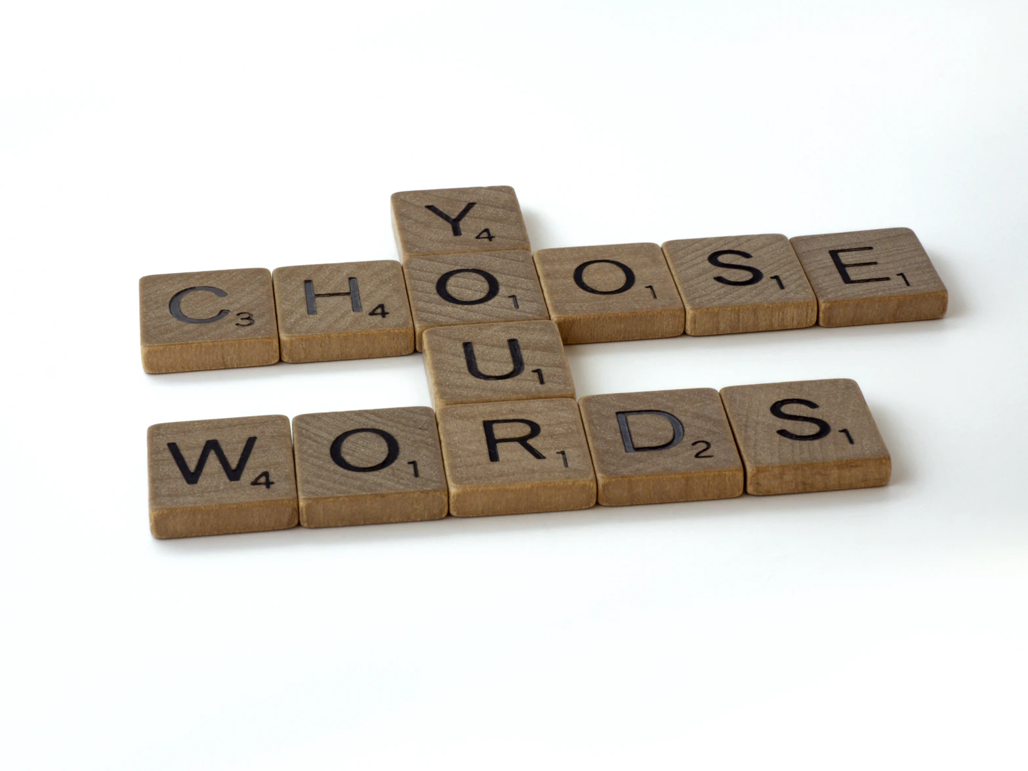
CUT WORDY STARTERS
Watch for 'it is' or 'there are' at the beginning of sentences
Other wordy starters are 'in terms of,' 'with regard to,'and 'on the subject of'

Slide 48
INSTEAD OF... TRY...
CUT WORDY STARTERS
There are 40 students studying in the library.
40 students are studying in the library.
It is vital that you phone the office immediately.
You must phone the office immediately.
4

Slide 49
INSTEAD OF... TRY...
CUT WORDY STARTERS
In terms of music, classical is my favourite.
Classical music is my favourite.
By analyzing the problem, it is possible...
Analyzing the problem allows...
4

Slide 50
USE ACTIVE VOICE

Slide 51

USE ACTIVE VOICE
Active voice emphasizes the subject of a sentence
The subject is who/what is doing the action
Active voice tends to be more direct than passive

Slide 52
INSTEAD OF... TRY...
USE ACTIVE VOICE
The dog was walked by my sister.
My sister walked the dog.
Data was analyzed by researchers.
Researchers analyzed data.
4

Slide 53
USE STRONG VERBS

Slide 54

USE STRONG VERBS
The reason for the bridge going over budget is that the materials increased in price.
Instead of using a nominalization (turning what should be a verb into a noun), use a strong verb!

Slide 55
USE STRONG VERBS
The bridge went over budget because the materials increased in price.

Slide 56
presents a summary
summarizes
provides an argument
argues
has a discussion
makes a suggestion
has the ability to
suggests
can
discusses
makes an assumption
assumes
is in agreement with
agrees
gives instructions
is in conflict with
instructs
makes a decision
conflicts
decides

Slide 57
COMBINE SENTENCES

Slide 58
COMBINE SENTENCES
I watched every Star Wars movie last week.
There are nine movies in total.
I watched all nine Star Wars movies last week.

Slide 59
TRIM CITED MATERIAL

Slide 60
CITED MATERIAL
direct quotations
paraphrase

Slide 61
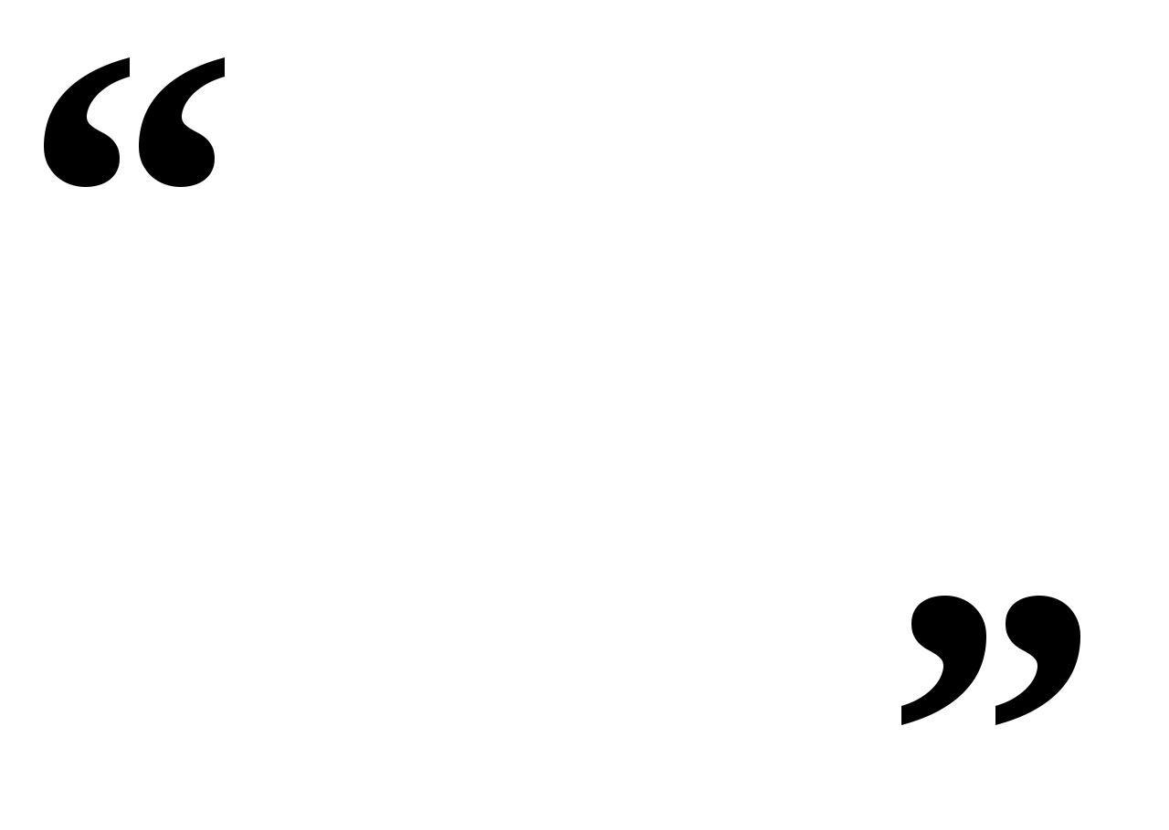
DIRECT QUOTATIONS
Use when it is important not just what was said but how it was said
Use when accuracy is critical
Use to capture specific language
Shorten using '…' where necessary

Slide 62

DIRECT QUOTATIONS
According to haunted house employees, people were "terrified, running out of [the building] screaming...they thought it was all real."

Slide 63

PARAPHRASE
Putting cited material into your own words
Can shorten cited material and improve clarity and flow
Demonstrates understanding of the material

Slide 64
PARAPHRASE
The haunted house patrons believed the scenes were real and ran screaming from the building.

Slide 65
LIMIT QUALIFIERS
USE ACTIVE VOICE
COMBINE SENTENCES
TRIM CITED MATERIAL
USE STRONG VERBS
CUT WORDY STARTERS
AVOID REDUNDANCY
LIMIT LONG PREPOSITIONAL PHRASES

Slide 66
QUESTIONS?
Remember, this slideshow and many others are available to download via the Writing Support Brightspace page.
Students can self-enroll as 'learners' either by selecting 'Discover' from the Brightspace landing page and clicking 'Enroll' on the Writing Support organization.

